Slide 1
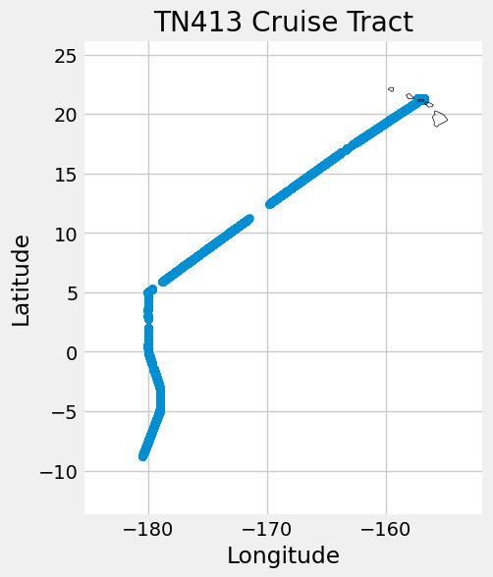
Predictions and Drivers of Phytoplankton Biomass in the Equatorial Pacific Using a Random Forest Machine Learning Model
Cristian Swift
University of Washington
School of Oceanography
Senior Thesis

Slide 2
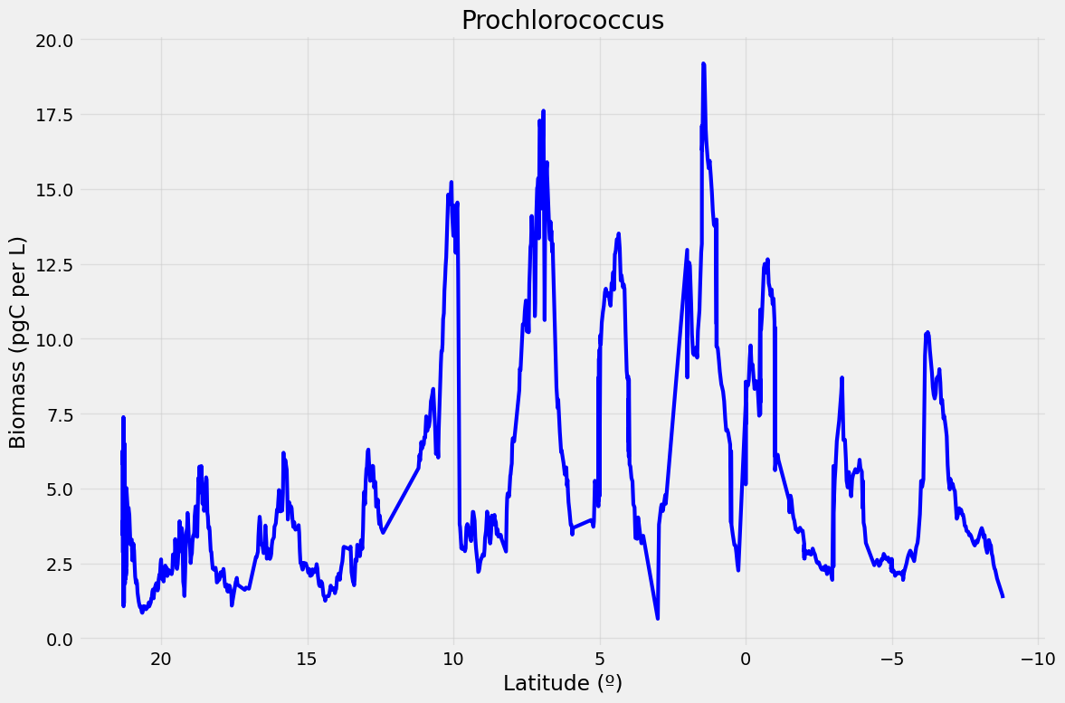

Introduction
Equatorial pacific is hard to access
Phytoplankton linked with the carbon they export
Temp, Salinity, Nutrients
Prochlorococcus, Synechococcus, picoeukaryotes
Notes:
Equatorial Pacifc is a region of high productivity due to converging winds at the equator causing upwelling of nutrient rich water
This area is hard to research due to its distance from large ports
Random forest is a commonly-used machine learning algorithm trademarked by Leo Breiman and Adele Cutler, which combines the output of multiple decision trees to reach a single result
I am using random forest to predict the drivers
Random forest model identifed what appeared to be the best ones. Big compenent, the bigest drivers are xyz, I used them and see upw well it performed.
Hypothesis: chlorophyll, nutrients, salinity and temperature measurements can predict Prochlorococcus, Synechococcus, and Eukaryotes biomass in the equatorial Pacific

Slide 3
Questions/Hypothesis
Can Model data be used to predict phytoplankton biomass?
What are these drivers of phytoplankton biomass?
Hypothesis: Nutrient concentration, salinity, and sea surface temperature are dominant determining factors of phytoplankton biomass because they represent key environmental conditions that influence the growth and distribution of phytoplankton in the world's oceans.

Slide 4
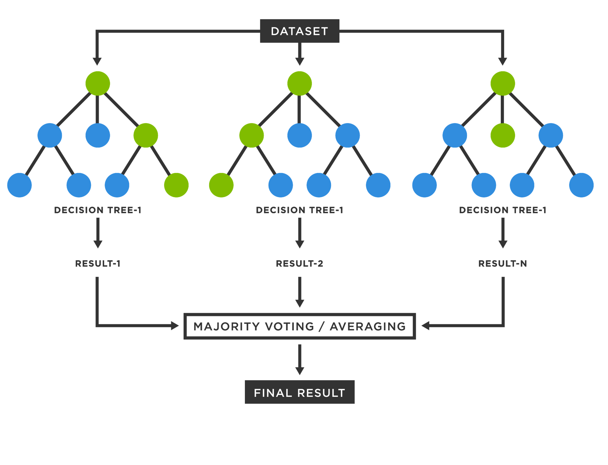
Methods
In situ temperature and salinity
SeaFlow
Pisces model nutrient data
Random Forest Regressor
https://www.analyticsvidhya.com/blog/2021/05/bagging-25-questions-to-test-your-skills-on-random-forest-algorithm/
Notes:
title - hint that I use random forest, talkn more about random forest - training data, testing a=data? one slide all for random forest and how the data was used
I identified critical things, and it idffered between the differnt organisms. Explain why this might be. salin is a good predictor of pro cuase of the salinity of the driver, hugh salin area nd pro is really happy
conclusion: salin is liekly correlated with abundance in te gyre.

Slide 5
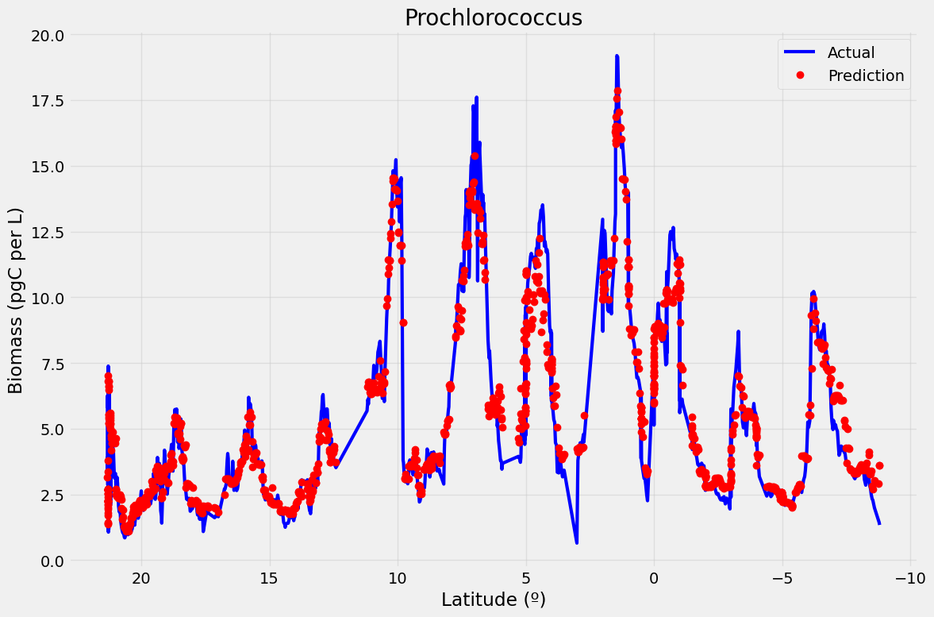
RF Model Predicted Well Across The Equatorial Pacific
Notes:
expamd more on stats for the fitting with three panales figure
have more energy

Slide 6
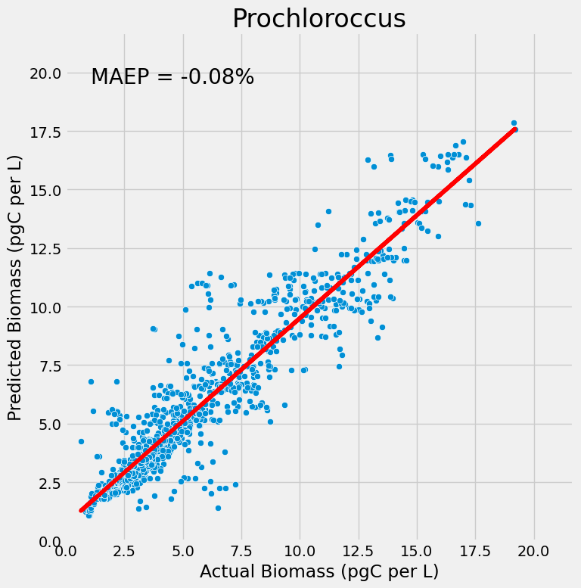
Actual versus Predicted Biomass
Notes:
Synechococcus: -16%
Picoeukaryotes: -3%

Slide 7
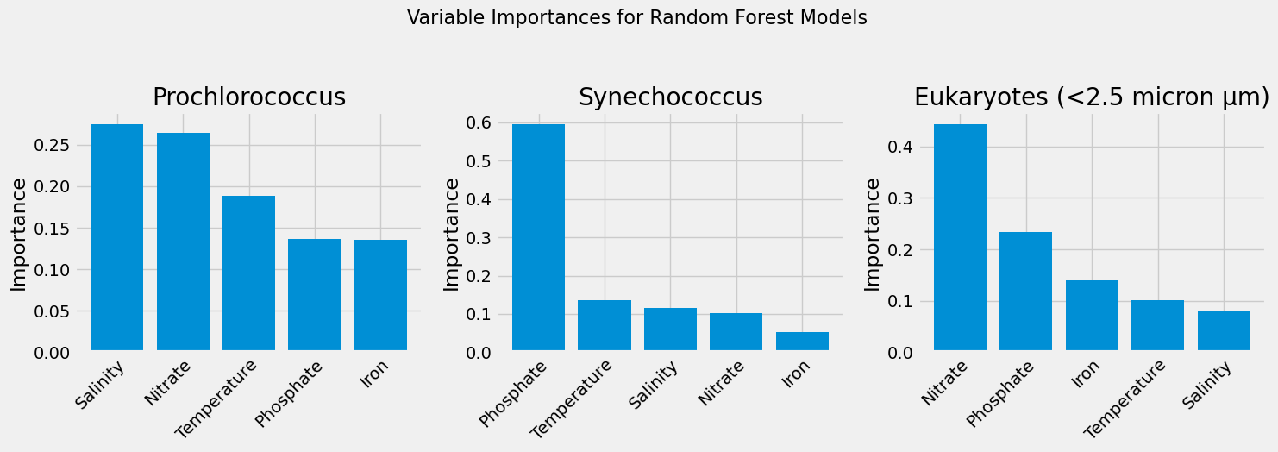
Drivers of Phytoplankton Biomass
Notes:
Pro – salinity and nitrate are decreasing in the equatorial Pacific, leading to lower pro abundances
Syn- phosphate is decreasing in the ocean
Eukaryotes – nitrate is decreasing

Slide 8

Conclusion and Next steps
Hypothesis Supported: Environmental in situ and model data worked well
Phytoplankton communities may be impacted differently
Next Steps: Washington NASA Space Grant
Use full model data
Add additional cruise data
Apply additional statistics

Slide 9


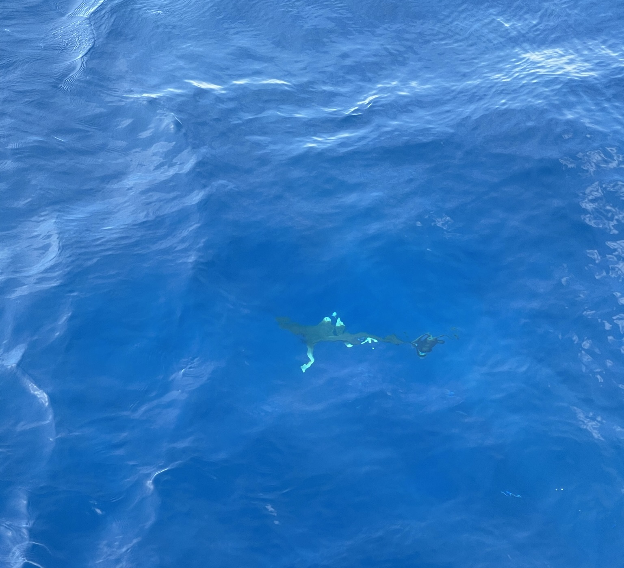
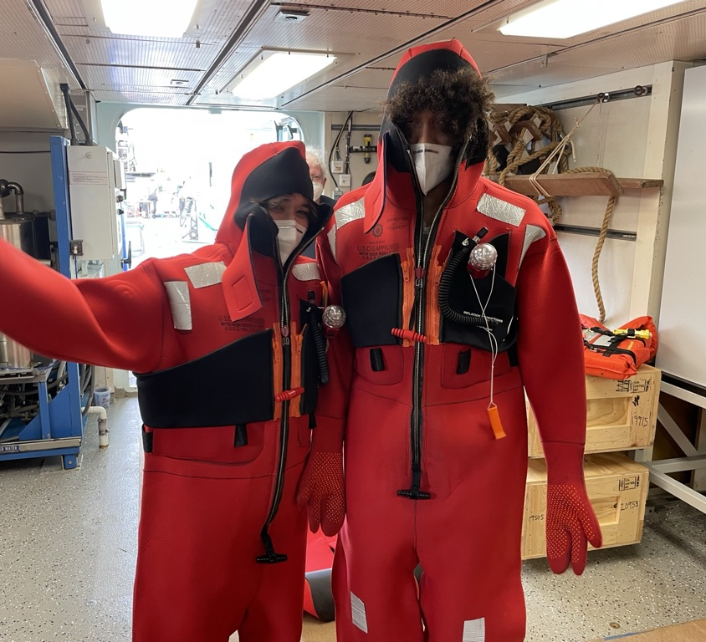
Acknowledgments
R/V Thompson Crew
School of Oceanography
Senior Thesis Teaching
Simon CMAP
Family
Leo Maddox Foundation

